Slide 1
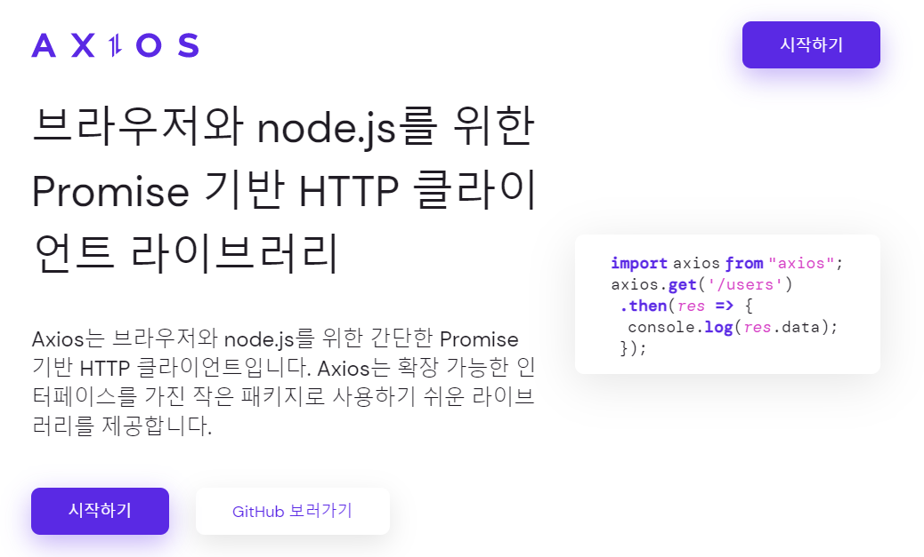
Axios-AJAX
https://axios-http.com/kr/docs/intro

Slide 2
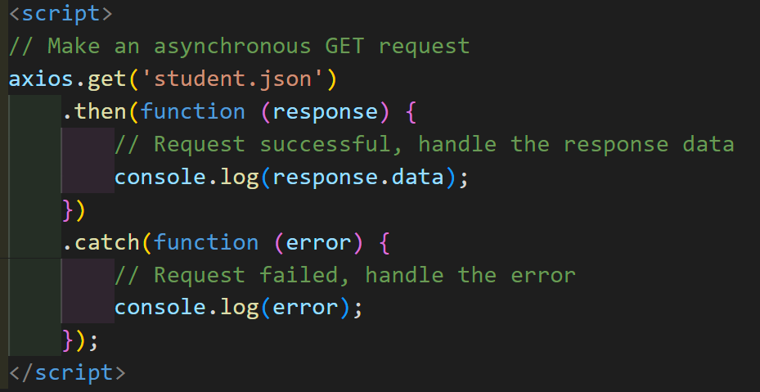
Axios-AJAX
<script src="https://cdn.jsdelivr.net/npm/axios/dist/axios.min.js"></script>

